Slide 1
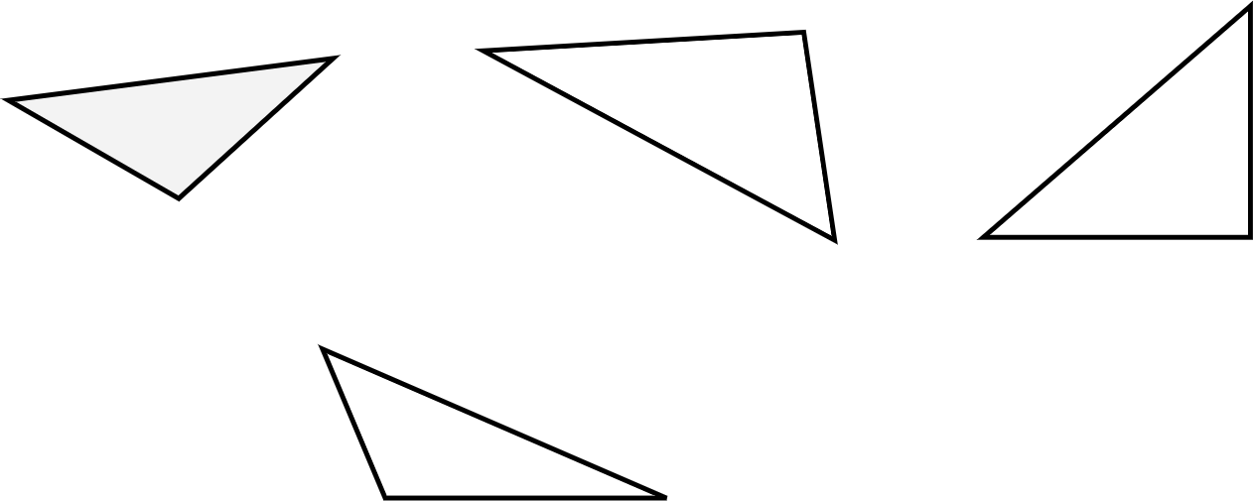
Area of a triangle
Task A: Reviewing the area and perimeter of a triangle
a) b) c)
5 cm
4 cm
2 cm
5 cm
3 cm
2.5 cm
4 cm
5 cm
d)
4 cm
4 cm
3 cm
1) For each triangle, do you have enough information to calculate the area, the perimeter, both or neither?
Explain how you know.
2) For the ones that are not possible, write the minimum additional information you need.

Slide 2






Area of a triangle
Task B: Deriving the formula for the area of a triangle
1) Instructions:
Take a piece of paper and fold it in half.
Draw a triangle on your piece of folded paper (try to make it different from mine).
Cut out your triangle. You should have two identical triangles due to your folded paper.
Put your two triangles next to each other. You can flip and/or rotate either of them.
Which quadrilaterals can you make?
2) Take your two triangles. Can you make each of the 6 quadrilaterals shown below?
List the quadrilaterals you can make.
Which quadrilateral can always be made?
Mathematics in Education and Industry.

